Slide 1
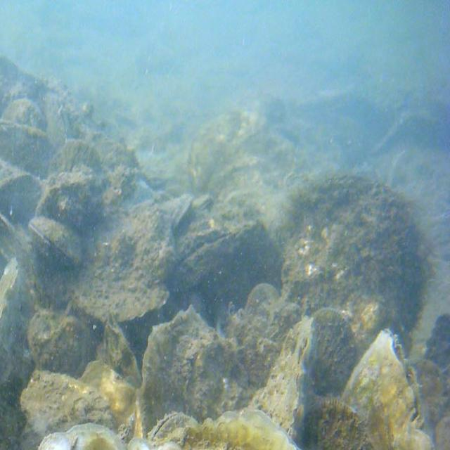

Oyster Life Cycle Classification
By Michael Straus, Joshua Essandoh, Nikolai Vukov
Mentors:
Dr. Yuanwei Jun, Dr. Enyue (Annie) Lu
Notes:
Speaker: Niko

Slide 2
Table of Contents:
Background and Objectives
2024 Objectives
Methods and Approaches
Expected Results and Impact
Timeline
Progress
Questions
Notes:
Speaker: Micheal

Slide 3
Background and Objective
Originates from a NSF REU summer project: "Oyster Orientation and Deep Learning Image Processing" By Joshua Comfort, Ian Rrudy and mentored by Yuanwei Jin
Previous project was able to implement YOLOv5, a deep learning detection model
YOLOv5 was able to recognize and classify the oysters into 3 stages: Slightly Open, Open, and Closed
Notes:
Speaker: Josh
We aim to build upon the previous work done on Oyster Orientation and Deep Learning Image Processing by Joshua Comfort, Ian Rudy, and Dr. Yunawei Jin. Our job is to work in tandem with the USDA to detect oysters using image processing software. This is done thru CNN, which is a deep learning model, that consists of manyIn the results, the research team was able to implement YOLOv5, a deep-learning detection model used to recognize and classify the oysters into 3 different states: slightly open, open, and closed. What we can improve is incorporate the updated version of YOLOv5, YOLOv8 and expand the use of the system to detect depth as well.

Slide 4
2024 Objectives
Build off previous work with the goal of improving and updating the program to the newest version of YOLOv10
Advance the project from images to videos using YOLOv10
Implementing DenseDepth to create a 3D bounding box as opposed to 2D to improve confidence of data and improving quality within the code.
Hoping to publish our results via a conference paper.
Notes:
Speaker: Josh

Slide 5
Methods and Approaches
Plan on working on this project via Google Colab which allows access to GPUs, requires zero configuration, and is easy to share.
Using the Ultralytics guide and pip packages to implement the newest version of YOLOv10.
Using 3D boundary boxes to add depth to outline oysters using Dense Depth (as shown in next slide) to accurately convey the orientation of the oysters numerically.
Notes:
Speaker: Michael

Slide 6
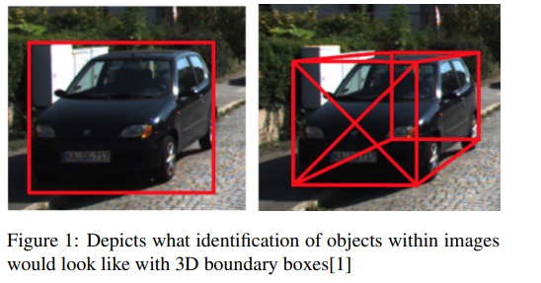
Notes:
Speaker: Micheal

Slide 7
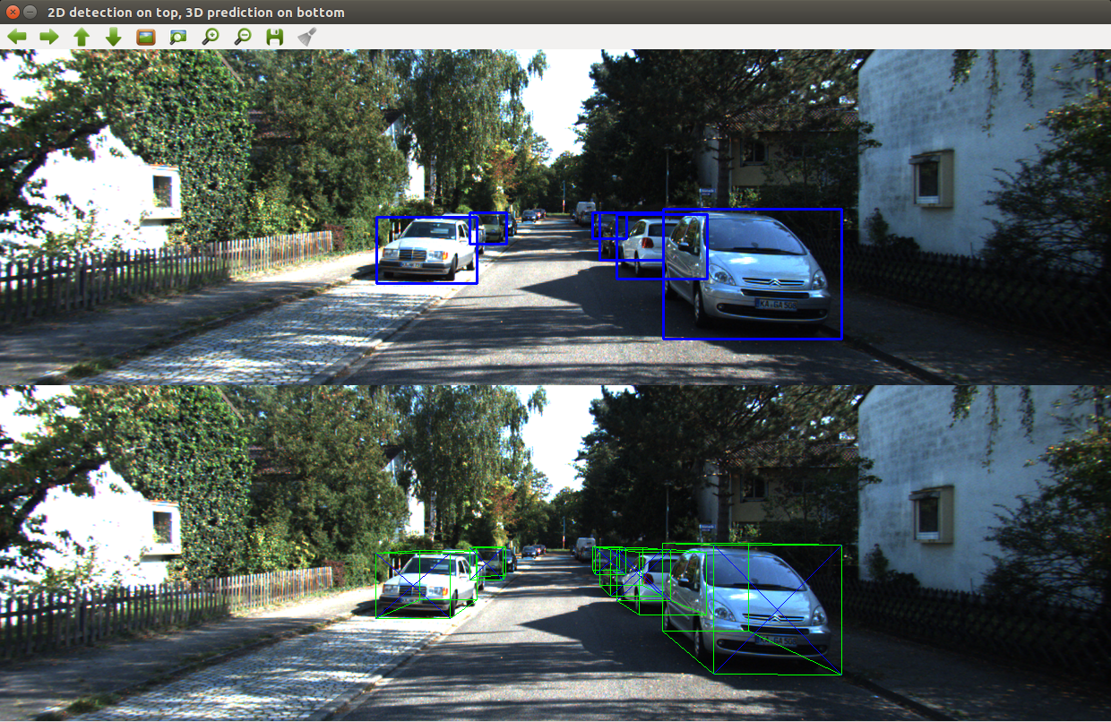
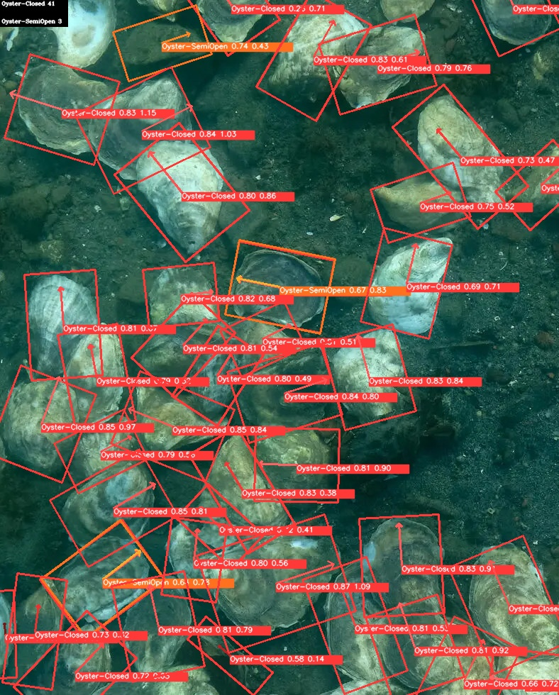
Expected Result and Impact
Faster and more precise detection of oysters with better orientation
Improved analysis of 3 dimensions
Notes:
Speaker: Niko

Slide 8
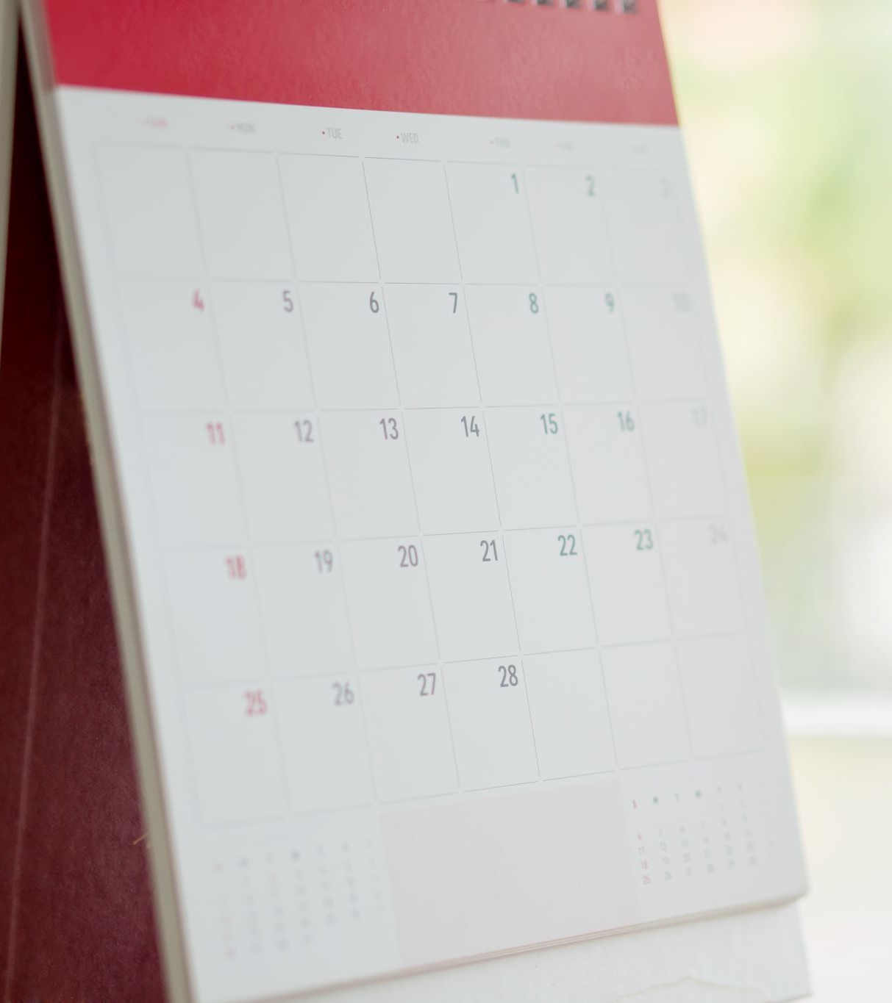
Timeline
Week 1-2: Familiarization with project as well as finding new ways to add to existing project
Week 3-5: Implement new image detection system and replace YOLOv5
Week 6-8: Adapt current image processing to processing videos as well as adding on to DenseDepth system.
Week 9-10: Wrap up and prepare paper to publish
Notes:
Speaker: Josh

Slide 9
Progress
Gathered our sample of images as well as video samples, total of 885 images
Annotated more than half of the images using Roboflow
Reviewed/edited existing code
Working to implement YOLOv10/image processing software
Notes:
Speaker: Niko

Slide 10
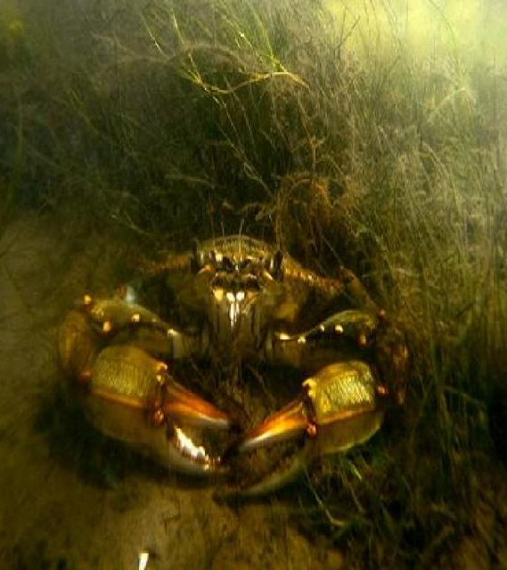
Questions?

Slide 11
References
[1] Joshua Comfort and et al. Detecting the multiple states of oyster activity and
orientation using deep learning image processing and computer vision algorithms.
Journal of Marine Science and Technology, 1(1):1–5, 2022.
[2] Arsalan Mousavian and et al. 3d bounding box estimation using deep learning and
geometry. In Proceedings of the IEEE conference on Computer Vision and Pattern
Recognition, 2017.
[3] Ian Rudy, Alexander Emmert, Alexander Mekovsky, Yuanwei Jin, and Enyue Lu.
Machine learning and computer vision techniques to identify and monitor ostreidae
nondisruptively. ACM Mobile Computing, 1(1):1–6, 2023.

